Slide 1


English 7
UNIT 7 . TRAFFIC
PERIOD 54: GETTING STARTED
MONDAY IN THE PLAYGROUND
Welcome to our class

Slide 2

Bus
lorry
train
Car
Means of transport
Coach
Motorbike
plane
bike
Boat
Ship

Slide 3
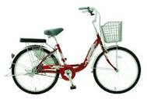
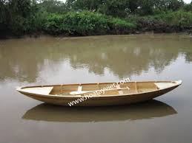
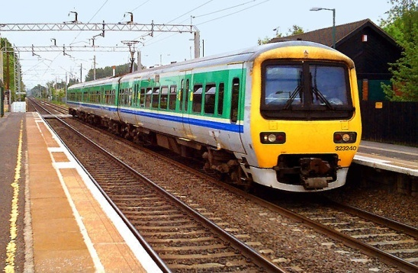
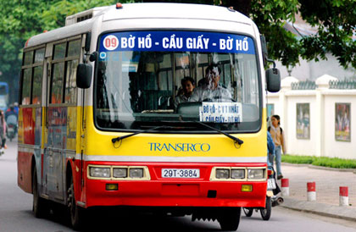
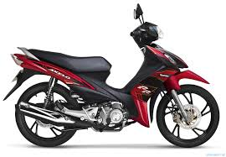
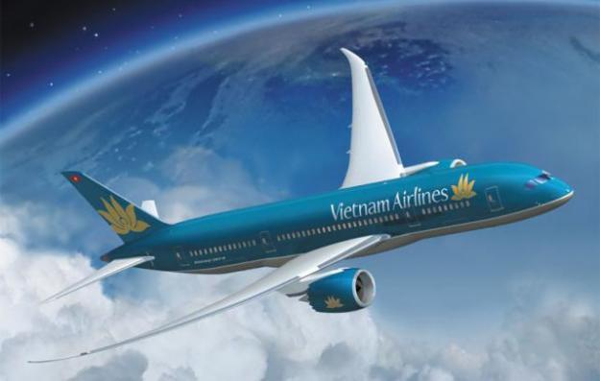
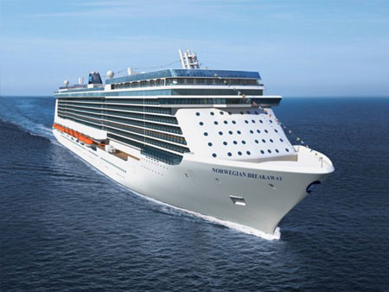
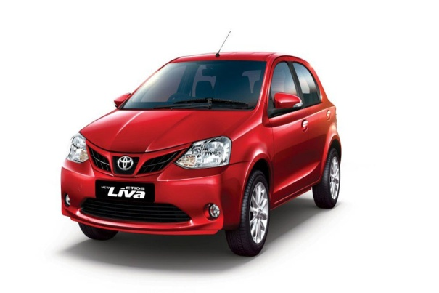
Look at the pictures and write the names of things
1
4
6
bicycle
boat
train
Means of transport
2
7
bus
motorbike
8
3
5
car
plane
ship

Slide 4


II : LISTEN AND READ
Mai: Hi , Oanh .How are you ?.
Oanh : Hi. Mai. I’m OK , thanks How about you ?
What did you do yester day ? .
Mai: I’m good Yesterday morning I stayed at home and played with my brother .In the afternon I cycled round the lake near my home .
Oanh : Oh , good , that sounds really healthy , By the way , how do you come to school ?
Mai: My dad usually drives me to school . I used to go on foot when I was in primary school . But the new school ‘s too far to walk now
Oanh : How far is it from your house to here ?
Mai: It’s about two kilometres
Oanh : How long does it take you ?
Mai: About 10 minutes Sometimes when there are traffic jams,it take longer
Oanh : Do you come by car every day ?
Mai: Yes, except when my dad is busy .Then I come by bike
Oanh:I see Hey Mai How about going cycling round the lake on Saturday ?
Mai : Great idea! Can you come to my house at 3 pm ?
Oanh : OK , M ai .I can ‘t wait ! See you then

Slide 5
1. a, Choose the correct answer:
1. What did Mai do yesterday afternoon .
She stayed at home wwith her brother
She rode her bike around the lake
She walked round the lake
2. Oanh says that It’s healthy to…………… .
A. Cycle B. walk C. stay home
3. Mai used to go to school …………..
A. By car B. on food C. by bicycle
4. Mai and Oanh agree to go cycling …………….
A. tomorrow B. every day C. at the weekend

Slide 6
b. Answer question
1. What did Mai do on Sunday morning ? ……………………………………………………………
She played at home and played with her brother.
2. How far is it from Mai’ s house to school ?
……………………………………………………………
It’s about two kilometres .
3. Who does Mai usually go to school with ?
……………………………………………………………
She usually goes to school with her Dad .
4. Why does it sometimes take Mai longer to get to school ?
…………………………………………………………………
Because sometimes there are traffic jams
5. How does she go to school when her dad is busy ?
……………………………………………………………
She goes to school by bike

Slide 7
C. Can you find the following expressions in the conversation? Do you know what they mean ?
Hey -> to have someone’s attention . (này)
Great idea -> when you strongly support or agree with something . (Ý kiến hay)
Can’t wait -> very excited and keen to do something . (rất hào hứng, thích làm gì)

Slide 8
d. Work in pairs Make short role plays with the expression above then practise them
Example :
How about cycling to school with me tomorrow?
Great idea !
- Can you go to the zoo with us ?
Ok , I can’t wait ! what time ?

Slide 9
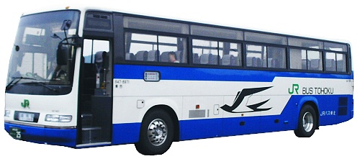
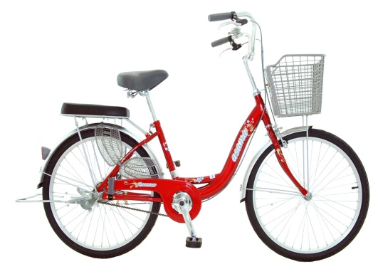
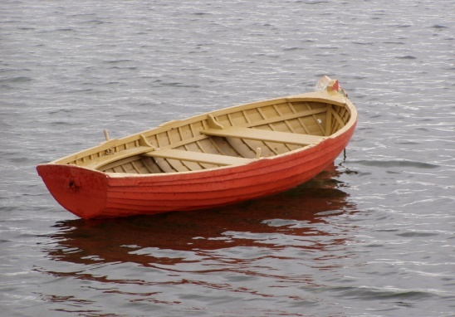
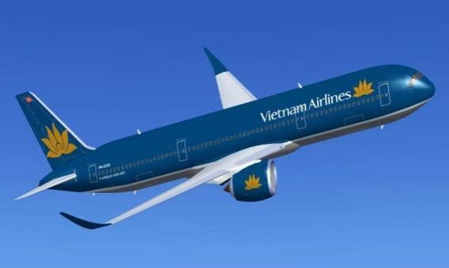
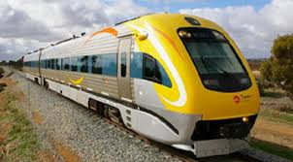
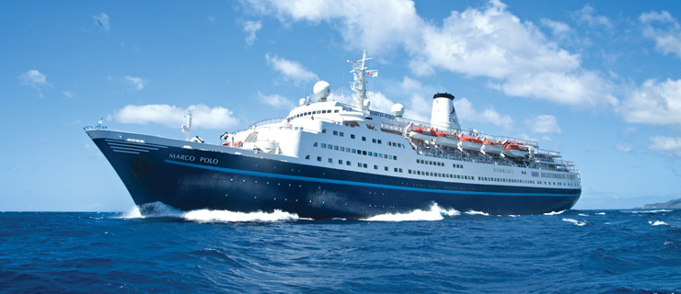
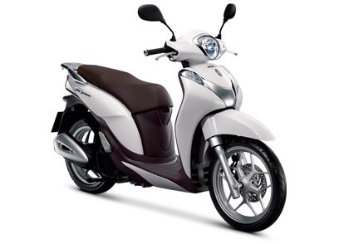
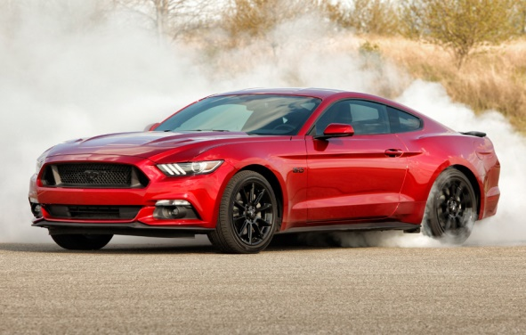
2. - MEANS OF TRANSPORT
- bus
- bicycle
- plane
- boat
- ship
- train
- motorbike
- car

Slide 10
1.ride
2.drive
3. fly
4. sail
5. get on
6. get off
3 Match a verb on the left with a means of transport on the right .then may be more than one correct answer .Add a preposition when necessary .:
A train
A boat
A bus
A bike
A car
A plane
- Make your own sentences with these phrases
Ex : 1d - My father taught me how to ride a bike
My mother often drives a car to work
I want to sail a boat on the river

Slide 11
4: Find someone in your class who never
1. walks to school
2. goes to school by bus
3. cycle for exercise
4. takes a train
5. sails on/in a boat
6.flies by plane
How often do you walk to school/ go to school by bus / cycle for exercise …………….?
Do you often walk to school / go to school by bus /

Slide 12

Homework
1- Learn by heart all the new words
2- Prepare new lesson

